Slide 1

DEPARTMENT OF ARTIFICIAL INTELLIGENCE AND DATA SCIENCE ACADEMIC YEAR 2025 - 2026 SEMESTER III ARTIFICIAL INTELLIGENCE LABORATORY MINI PROJECT REVIEW ROCK, PAPER, SCISSOR GAME USING MONTE CARLO SEARCH
REGISTER NUMBER | 2117240070028
NAME | ASHWITHA R
YEAR | II
SECTION | A
FACULTY IN-CHARGE | Mrs. M. Divya

Slide 2
PROBLEM STATEMENT
The game Rock–Paper–Scissors is a classic hand game of chance and strategy. Developing an AI that can adapt and make optimal decisions in such an uncertain environment is a challenge.
This project implements an AI agent using the Monte Carlo Tree Search (MCTS) algorithm to learn and make strategic decisions against human or simulated opponents.
The goal is to enable the AI to predict and counter human moves by evaluating possible future outcomes based on past interactions.
Expected Result:
An intelligent Rock–Paper–Scissors game system where the AI adapts dynamically to the player’s choices using MCTS simulations.

Slide 3
THEORETICAL BACKGROUND
Artificial Intelligence Concept:
Monte Carlo Tree Search (MCTS) is a heuristic search algorithm that combines random sampling and decision tree exploration to find the most promising move in uncertain games.
Justification for Choosing MCTS:
Effective for games with uncertainty or incomplete information.
Balances exploration (trying new moves) and exploitation (using known best moves).
Does not require prior knowledge or training data.
Algorithm Steps (UCT version):
1. Selection: Traverse the tree to select a promising node using the UCT formula.
2. Expansion: Add a new child node to explore an unvisited move.
3. Simulation: Play random games from that node to estimate outcome.
4. Backpropagation: Update the node’s statistics with simulation results.

Slide 4
IMPLEMENTATION AND CODE
Link to code in Git-hub Repository
List | Git-hub Repository Links
Implementation of Code Link | https://github.com/ASHWITHA2202/AI-mini-project/blob/main/import%20random.py
Word Document Report Link | https://github.com/ASHWITHA2202/AI-mini-project/blob/main/rock%20papaer%20scissor-Ashwi.docx
PPT Link | https://github.com/ASHWITHA2202/AI-mini-project/blob/main/ASHU_MINI_PROJECT_AI%5B1%5D%20(1).pptx

Slide 5
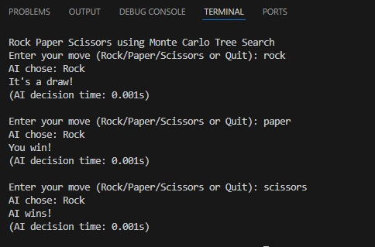
OUTPUT AND RESULTS

Slide 6
OUTPUT AND RESULTS
Results:
The AI improves decision-making with more simulations.
MCTS effectively predicts the next move pattern of the player.
Adaptive and randomized strategy reduces predictability.
Future Enhancements:
GUI-based gameplay with visualization of MCTS tree.
Integration with reinforcement learning for improved adaptation.
Extend to multi-round strategy analysis.

Slide 7
REFERENCES
1. Browne, C. et al. “A Survey of Monte Carlo Tree Search Methods.” IEEE Transactions on Computational Intelligence and AI in Games, 2012.
2. Sutton, R. & Barto, A. “Reinforcement Learning: An Introduction.” MIT Press, 2018.
3. Python Official Documentation – https://docs.python.org
4. ResearchGate – “MCTS applications in Game AI.”
5. GitHub Repositories on Monte Carlo Tree Search implementations.

